Slide 1
AI Strategy and Governance
AI Governance
Kartik Hosanagar, Professor of Operations, Information and Decisions

Slide 2

User Control
Giving users some control over the decisions algorithms make for or about them
E.g., Facebook newsfeed now allows users to flag posts in their newsfeed as being false or offensive
System has helped detect many problematic posts
In 2015, Facebook released mixed-style newsfeed controls
Allowed users to decide whether they wanted more/less of particular news (relationship statuses, profile changes, specific friends, etc.)
User satisfaction did increase (people liked having control)
But engagement went down (the algorithm knew what would engage users better than the users themselves)
Demonstrates that there is a role for providing user control, but it needs to be balanced with ensuring the algorithm performs well
Content/quotes from: “A Human’s Guide to Machine Intelligence” by Kartik Hosanagar

Slide 3
User Control - Experiment
Users were asked to predict the score that high school students would receive in standardized tests based on information they had about these high school students
Users were allowed to consult algorithms
Users were divided into 4 groups
Group 1 — no control over the algorithm
Groups 2 and 3 — very limited control over the algorithm
Group 4 — complete control over the algorithm
Content/quotes from: “A Human’s Guide to Machine Intelligence” by Kartik Hosanagar

Slide 4
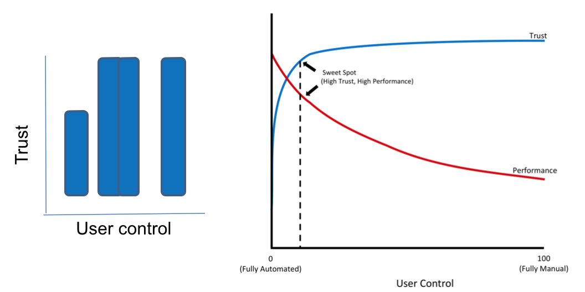
User Control - Experiment
Users with no control had low trust — they were less willing to use the algorithm
Users with even a little bit of control had very high trust — they were willing to use the algorithm much more
The amount of control didn’t matter — whether users had little control or a lot of control the trust levels continued to be high and similar
Content/quotes from: “A Human’s Guide to Machine Intelligence” by Kartik Hosanagar

Slide 5
Transparency for End Users
Users can also be uncomfortable with decisions made by algorithms if they feel they don’t understand those decisions
Solutions to this sometimes focus on technical transparency
Technical transparency = revealing source code
Examples: 2015 CFTC ruling on 2010 flash crash, 2017 NYC proposed bill on automated decisions
Problems with technical transparency: Doesn’t protect intellectual property, creates vulnerability to adversarial attacks, doesn’t always explain decisions (in cases of deep learning, random forests, etc.)
Moreover, technical transparency may not even be necessary or helpful in improving user trust
Content/quotes from: “A Human’s Guide to Machine Intelligence” by Kartik Hosanagar

Slide 6
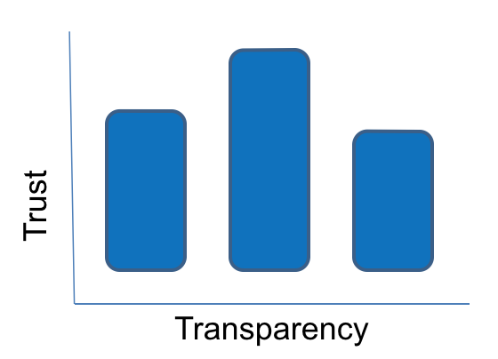
Transparency for End Users
In a study on grading by Rene Kizilcec, students who were provided a limited amount of transparency had the greatest trust in their grades
Those who were given more extensive explanations of how the algorithm functioned had trust levels similar to those with no explanation at all
“Calibrated transparency” is a better approach
Was an algorithm used to make a decision?
What kinds of data are used?
What variables are considered?
Global and local interpretability
Content/quotes from: “A Human’s Guide to Machine Intelligence” by Kartik Hosanagar

Slide 7
Transparency for Managers and Data Scientist
Many of the best performing ML models are often highly opaque (e.g. Neural Network making loan approval decisions)
Recent interest in Interpretable ML (also known as Explainable AI)
Global interpretability: Can we explain at a high level what are the most important variables driving a model’s predictions (e.g. income, credit history, etc)?
Local interpretability: Can we explain the most important variables driving a particular prediction or decision (why Kartik’s loan application was not approved)?
Many open source tools and third-party vendors are starting to offer model interpretability solutions
Can be valuable for debugging

Slide 8
Auditing Algorithms
Due to the risks automated decisions bring, ML should be designated as a distinct model type, with its own governance frameworks
The Algorithmic Accountability Act could be one such framework
If passed, it would require large companies to formally evaluate their “high-risk automated decision systems” for accuracy and fairness
But forward-thinking companies should not wait for regulation
What would an audit look like?
An audit process would begin with the creation of an inventory of all machine learning models being employed at a company as well as:
The specific uses of these models
The names of the developers & business owners of models
Risk ratings: the social/financial risks if the model fails

Slide 9
Auditing Algorithms
For high-risk models, the audit should look at the following three areas:
Inputs
Model
Outputs
Data quality
Bias in training data
Alternative models
Statistical tests for model fit, overfitting
Model transparency
Stress test against simulated data
Decisions with explanations
Outliers: range of inputs and outputs
Machine learning models involve a variety of complex issues, such as bias, interpretability, and the fact that they are constantly retraining as they receive more data

Slide 10
Three Lines of Defense
Managing risks
Three lines of defense for data science
Control
Transparency
Audits
Data Science Auditor
(for high-stakes models)
Model Developer
Data Science QA

Slide 11
AI Strategy and Governance
AI Ethics Principles
Kevin Werbach, Professor of Legal Studies and Business Ethics

Slide 12
AI Ethics Principles
Consider what high-level principles should guide your AI initiatives
Setting them out explicitly makes it easier to evaluate decisions against a standard, and it can highlight concerns to worry about before problems occur
It’s also chance to consider what values are most important to your particular organization
Based on your history, your culture, your industry, your geographic location, or some other factors, you might be particularly concerned about certain principles

Slide 13
AI Ethics: 2020 Harvard Report
Evaluated 36 major AI ethics frameworks, coming from big companies like Microsoft, Telefonica, and Tencent; standards bodies; industry coalitions; and governments around the world
Eight common categories:
Privacy
Accountability
Safety and security
Transparency and explainability
Fairness and non-discrimination
Human control
Professional responsibility (infusing ethical and legal concerns throughout the process and the organization
Promotion of human values (asking whether your actions are ultimately in service of human flourishing

Slide 14
AI Ethics Principles
An important finding of the Harvard report was that principles seem to be converging
Companies and governments are considering existing frameworks and not trying to reinvent the wheel
That doesn’t mean there will ever be a uniform set of principles for everyone — organizations, communities, and cultures differ
It does mean the list of possible starting points for your own AI ethics principles is fairly short

Slide 15
How to Make These Principles Be More Than Just Slogans
Consider how your AI ethics principles connect with your larger organizational values
If you define yourself as a customer-centric company, are you truly customer-centric in your AI initiatives?
If you’ve made a public commitment to racial justice, can you identify how it manifests itself in your business applications of AI and other forms of data analytics?
Make sure you have both concentrated expertise on the legal and ethical considerations around AI and a culture in which everyone considers themselves responsible for asking ethical questions

Slide 16
AI Strategy and Governance
Explainable AI: Examples of When Explainability is Important
Prasanna (Sonny) Tambe, Associate Professor of Operations, Information and Decisions

Slide 17
Explainability and HR
Equal Employment Opportunity Commission guidelines
Certain HR practices that govern how HR decisions are made
HR legal framework requires being able to very clearly document how a decisions is made
When using an algorithm in HR, it is critical that you understand how the algorithm arrived at a decision

Slide 18

Explainability and Autonomous Vehicle Systems
If something goes wrong, it’s important for the company to be able to go back and understand exactly what went wrong

Slide 19
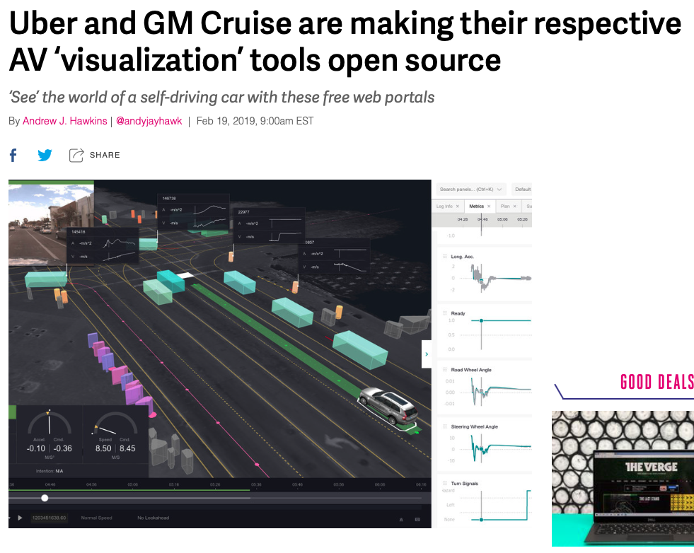
2 AV Companies Have Become Leaders in the Area

Slide 20
Explainability and Data Privacy
General Data Protection Regulation (GDPR)
When an algorithmic decision is made, the logic must be explainable to whomever the decision pertains to

Slide 21
Explainability and Customer Service
Explaining outcomes in financial lending, healthcare, loan processing, or other contexts

Slide 22
AI Strategy and Governance
Explainable AI: Tradeoffs Between Interpretability and Performance
Prasanna (Sonny) Tambe, Associate Professor of Operations, Information and Decisions

Slide 23
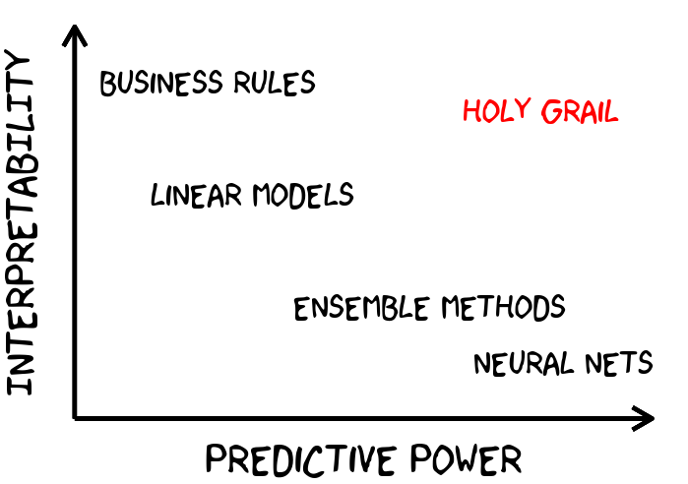
The Performance Penalty of Explainability

Slide 24
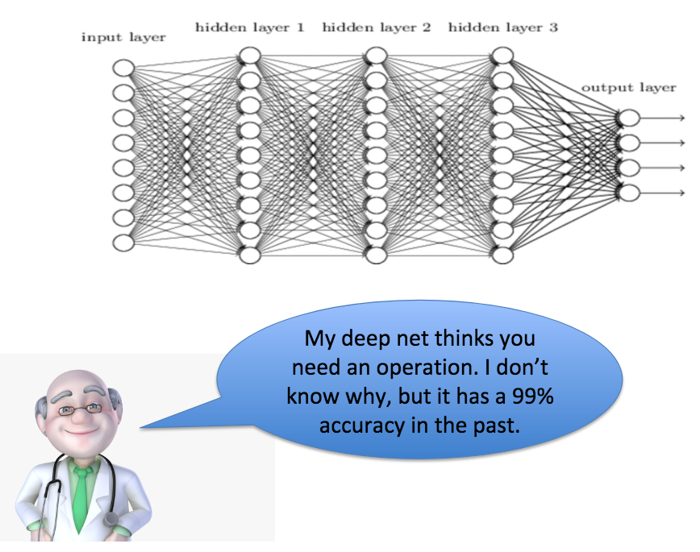
Explainability Tradeoffs
When is explainability more important than accuracy?

Slide 25
AI Strategy and Governance
Explainable AI: Approaches to Explainable AI
Prasanna (Sonny) Tambe, Associate Professor of Operations, Information and Decisions

Slide 26
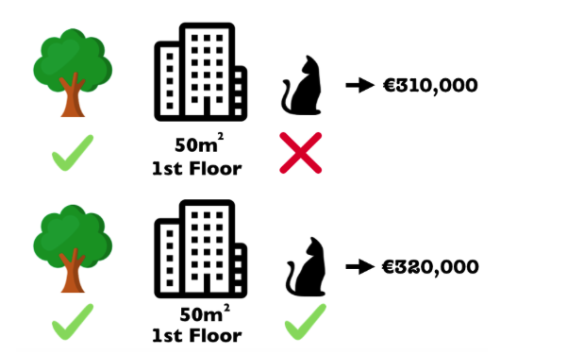
Approaches to Explainable AI
SHAP (Shapley Additive Explanations)
Identify the importance of each feature
Goal of SHAP is to explain the prediction of an instance x by computing the contribution of each feature to the prediction

Slide 27

Approaches to Explainable AI
LIME (Local Interpretable Model-Agnostic Explanations)
Generate a simpler linear approximation to a more complex boundary for the total data space you are dealing with

Slide 28
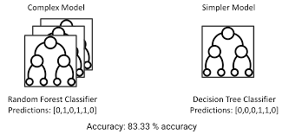
Approaches to Explainable AI
Surrogate decision trees
Generate a decision tree, which is easier to understand, that approximates a more complex model (e.g. deep learning neural nets)

Slide 29
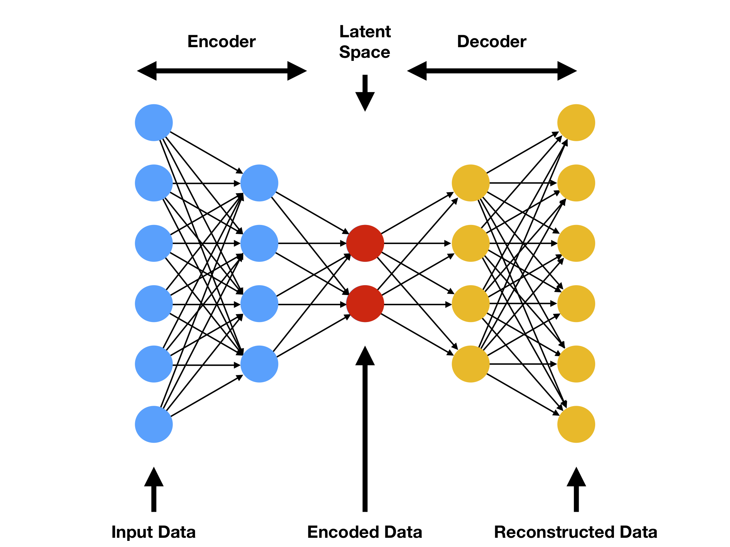
Approaches to Explainable AI
Variational autoencoders

Slide 30
Approaches to Explainable AI
Many companies working on integrating explainable AI (XAI) methods into their offerings
Microsoft InterpretML
IBM Explainable AI 360

Slide 31
AI Strategy and Governance
Explainability and the Law
Kevin Werbach, Professor of Legal Studies and Business Ethics

Slide 32
Transparency in Responsible AI
There are a number of existing and proposed legal frameworks that would mandate some form of explainability, at least in certain circumstances
If the AI system is a back box, there’s no way to evaluate whether, for example, it’s basing decisions on illegitimate factors, such as someone’s race or sexual orientation
More generally, it’s hard to assess what went wrong, or even if something did go wrong

Slide 33
Explainability and the Law
The most prominent existing model for legal explainability of AI is credit reporting
Credit bureaus, which developed in the 1960s, were one of the first major wide-scale application of data analytics in the economy
The power of credit reports meant an inaccurate report, or one used in a discriminatory way, could be devastating
Without regulation, there was no way for consumers to evaluate how credit reports fed into decisions

Slide 34
Explainability and the Law
Two laws from the 1970s in the US – the Equal Credit Opportunity Act (ECOA) and the Fair Credit Reporting Act (FCRA) – imposed standards for legal explanability of credit reports
Businesses had to give an adverse action notice when they denied someone credit, giving the “principle reasons” for the decision
Gave consumers information to contest the decision if appropriate, without placing an unreasonable burden on companies

Slide 35
Explainability and the Law
In some cases, governments mandate specific formats for disclosure
Credit card offers in the US must include a so-called Schumer Box which states interest rates and other terms in a standard, easy to understand way
Technology firms are experimenting with similar kinds of disclosures
Google’s Model Cards and Microsoft’s Data Sheets for Datasets
These help identify the source data and techniques involved in building the model
Some kind of standardized reporting, at least to regulators, seems likely in the future for major AI systems

Slide 36
Explainability and the Law
The GDPR includes a “Right to explanation” in limited cases for fully automated processing
In the US, at least one federal appeals court case involving teachers in Houston who were fired because of a black-box assessment algorithm based on their students’ test scores, found that the absence of explanation was a violation of Constitutional Due process rights
In any case where legal liability needs to be assigned, such as accidents involving autonomous vehicles, investigators are able to get access to data to understand exactly what happened and why

Slide 37
Explainability and the Law
The Algorithmic Accountability Act, as well as the EU’s AI white paper, both propose a requirement for formal impact statements before high-risk AI systems are deployed
High-risk means systems with a significant possibility of causing illegal discrimination, injury, or major financial consequences if something goes wrong
An algorithmic impact statement would force companies or government agencies to explicitly identify how the systems are working
Such impact statement may or may not have to be disclosed publicly
Either way, companies will be required to show regulators that they took the required steps and addressed possible harms their assessments turned up

Slide 38
Explainability and the Law
These potential legal explainability requirements will drive researchers and vendors to develop better techniques and tools for explainable AI
Being able to understand better how AI systems make decisions will benefit everyone

Slide 39


